Slide 1






PIZZA SALES ANALYSIS

Slide 2



Project Overview
This project showcases my SQL and Python skills through pizza sales data analysis, revealing actionable business insights. Using SQL for querying and Matplotlib for visualizations, I extracted insights into sales patterns, revenue drivers, and customer behavior.

Slide 3
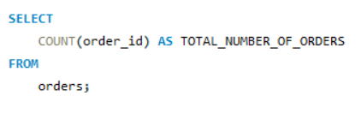

Retrieve the total number of orders placed.

Slide 4
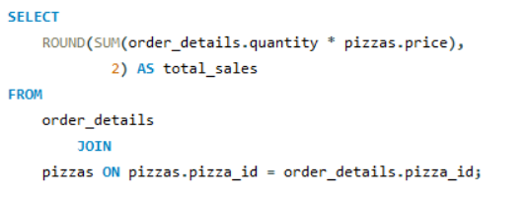

Calculate the total revenue generated from pizza sales.

Slide 5

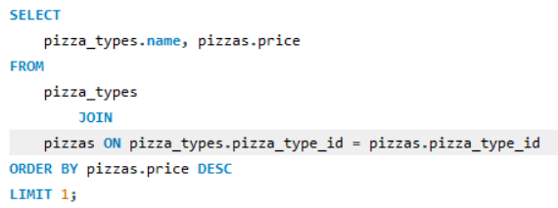


Identify the highest-priced pizza.

Slide 6
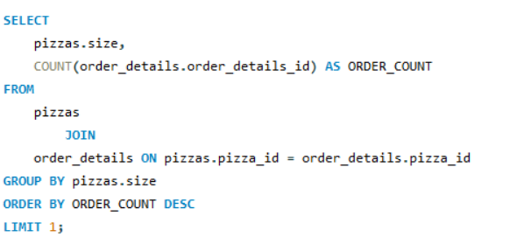

Identify the most common pizza size ordered.

Slide 7
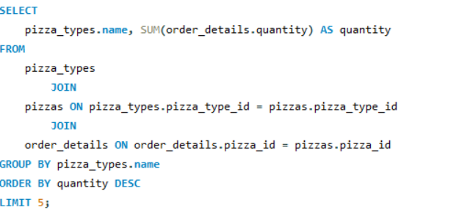

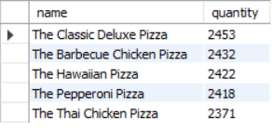
List the top 5 most ordered pizza types along with their quantities.

Slide 8
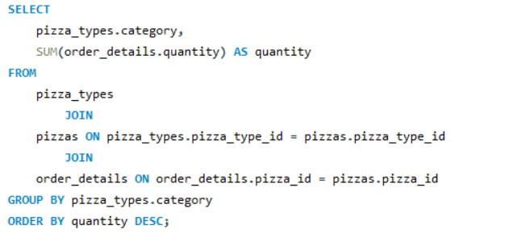
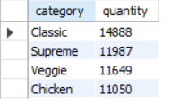
Join the necessary tables to find the total quantity of each pizza category ordered.

Slide 9
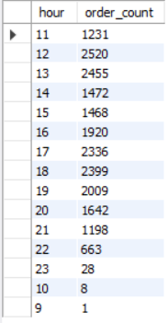
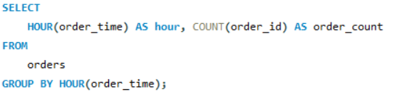

Determine the distribution of orders by hour of the day.

Slide 10
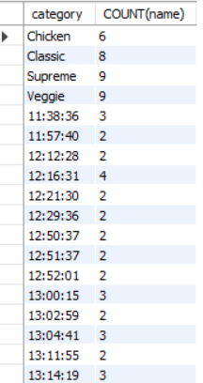
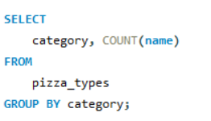
Join relevant tables to find the category-wise distribution of pizzas.

Slide 11
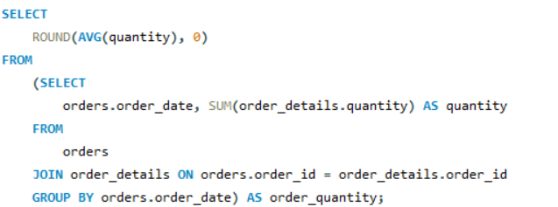

Group the orders by date and calculate the average number of pizzas ordered per day.

Slide 12
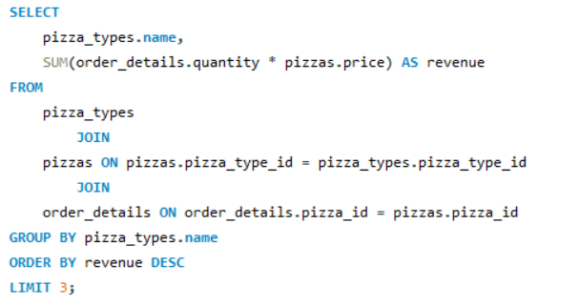

Determine the top 3 most ordered pizza types based on revenue.

Slide 13
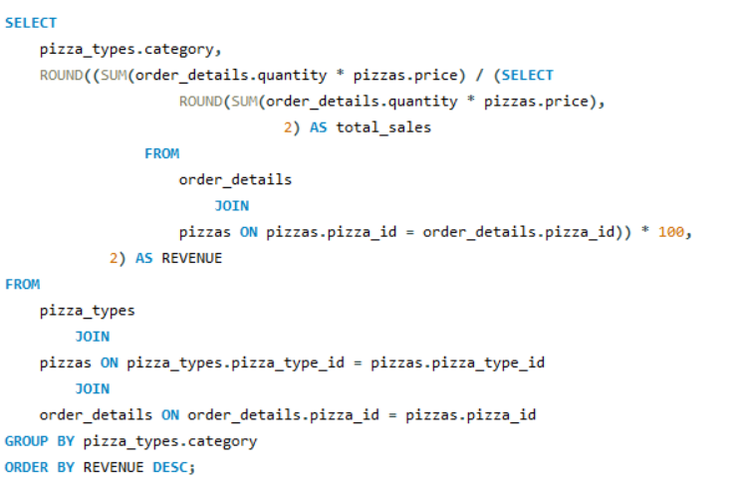
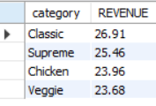
Calculate the percentage contribution of each pizza type to total revenue.

Slide 14
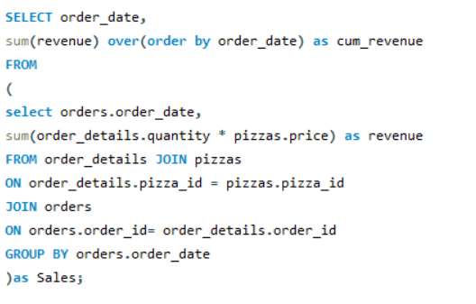
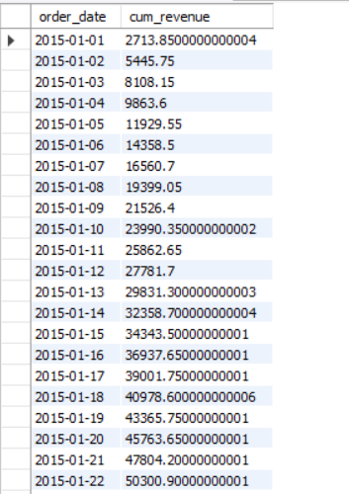
Analyze the cumulative revenue generated over time.

Slide 15
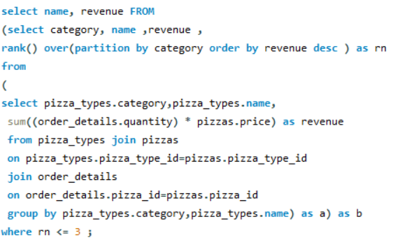
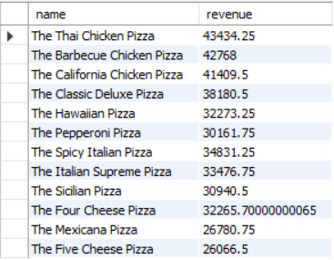
Determine the top 3 most ordered pizza types based on revenue for each pizza category.

Slide 16
Thank You

